Slide 1

Advances in poultry early nutrition: Focus on protein and digestive dynamics
Marisabel Caballero Global Category Manager Monogastrics Hamlet Protein

Slide 2

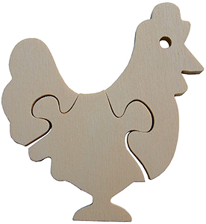
Objective of poultry production
The conversion of the nutrients from the diets into protein for human consumption…
in the most efficient way.
Health
Nutrition
Environment & Management
Genetics

Slide 3
Improvements increase the pressure during the starter period
Aviagen, 2022

Slide 4
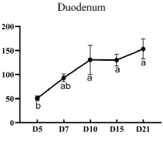
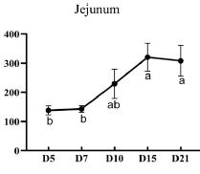
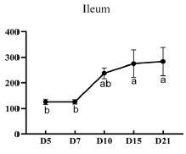
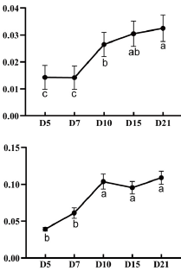
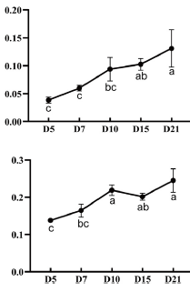
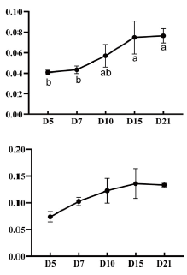
Proteolytic enzyme activity in broiler’s digesta is very low up to day 10 of life – hindering protein digestibility
Arbor Acres broilers corn-SBM based diets
Duodenum
Jejunum
Ileum
Trypsin activity (U/mg protein)
Carboxypeptidase A activity (ng/mg protein)
Aminopeptidase N activity (ng/mg protein)
Ma et al., 2024

Slide 5
How can we improve… - Tissue deposition efficiency - Animal productivity

Slide 6
Focus: nutrition
Protein sources: advantages & disadvantages
Soybean meal quality: thresholds for anti-nutritional factors?
Digestive dynamics: new research (and variables) to consider in nutrition
Protein kinetics: why fast protein?
Practical considerations: what to put into practice

Slide 7
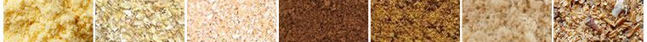
(some) Protein sources used in poultry (starter) feeds
Source | Advantages | Disadvantages
Animal proteins | High digestibility Excellent amino acid content | Microbial contamination Reactive oxygen species (ROS) Biogenic amines
Corn Gluten Meal (CGM) | High protein & methionine | Low threonine & tryptophan High fiber
DDGS | High protein & energy Cost-effective | Mycotoxin contamination High variability
Potato protein | High protein content High digestibility | Trypsin inhibitors & solanine Poor amino acid profile
Rapeseed (canola) meal | Good protein content Good amino acid profile (high lysine) | Glucosinolates Phytic acid Non-starch polysaccharides (NSPs)
Soybean meal (SBM) | High availability Good digestibility Excellent amino acid content | Trypsin inhibitors α-galacto-oligosaccharides Β-conglycinin

Slide 8
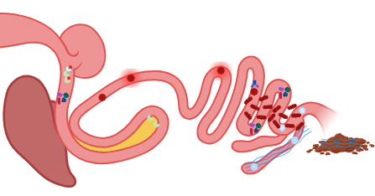
Soybean meal, the predominant protein for animal nutrition, contains anti-nutritional factors, hindering performance during critical periods
1
Trypsin inhibitors bind to trypsin
9
and allergic reactions, disrupting the gut barrier
ANF | Recommended*
Trypsin Inhibitor Activity (TIA) | <1.4 mg/g in the diet
α-Galacto-oligosaccharides (GOS) | <1.25% in the diet
β-conglycinin (β-CON) | <25000 ppm in diet
8
β-con causes inflammation
2
hindering protein digestion
3
Free proteins in the hindgut favor the growth of pathogenic bacteria
7
and favor the growth of pathogenic bacteria
The pancreas compensates by secreting more trypsin, provoking its enlargment
4
5
α-GOS are not digested
6
absorb water
SBM ANFs are a factor for dysbiosis and diarrhea
*in starter feed

Slide 9
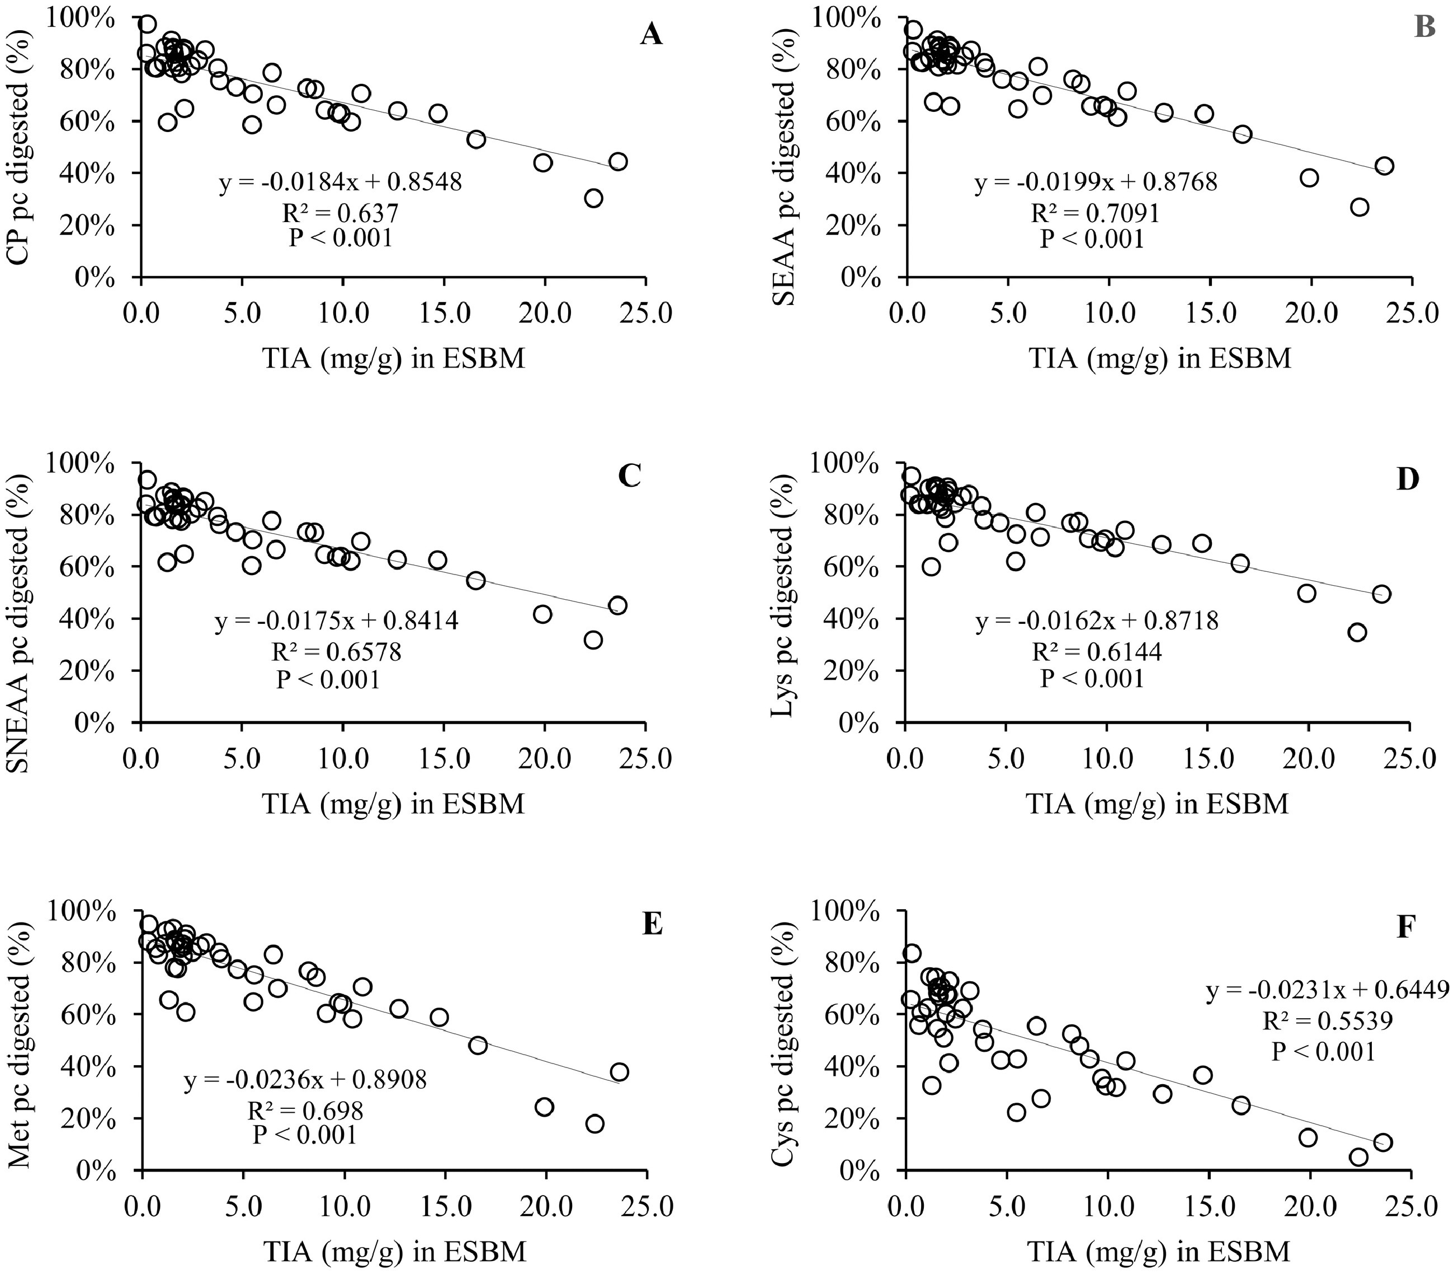
Recommended TIA limit < 1.4 mg/g feed - background
TIA mg/g in Expellers SBM
TIA mg/g in Expellers SBM
TIA significantly depressed 21-day-old broilers’ pre-cecal digestibility of amino acids (P < 0.001). SEAA: sum of essential amino acids
SNEAA: sum of non-essential amino acids
Levels from 0.4 to 8.5 mg/g in feed, 91 diets. Lowest intercept: arg (1.21 mg/g TIA) ranging from 1.6 to 1.8 mg/g TIA in feed
https://doi.org/10.1016/j.psj.2022.101740
9
Kuenz et al., 2022

Slide 10
TIA levels in SBM of different origins
Chen et al., 2020

Slide 11
Recommended α-GOS limit < 1.25% in feed - background
% GOS in feed
% GOS in feed
Diet were based on soy protein isolate (SPI) + α-GOS at 0.0, 0.9, 1.8, 2.7, or 3.6% added stachyose and raffinose in a ratio of 4:1.
α-GOS increase FCR in 21-day-old chicks.
α-GOS increase moisture in excreta, compromising gut health
https://doi.org/10.1016/j.psj.2022.102440
Teague et al., 2023

Slide 12
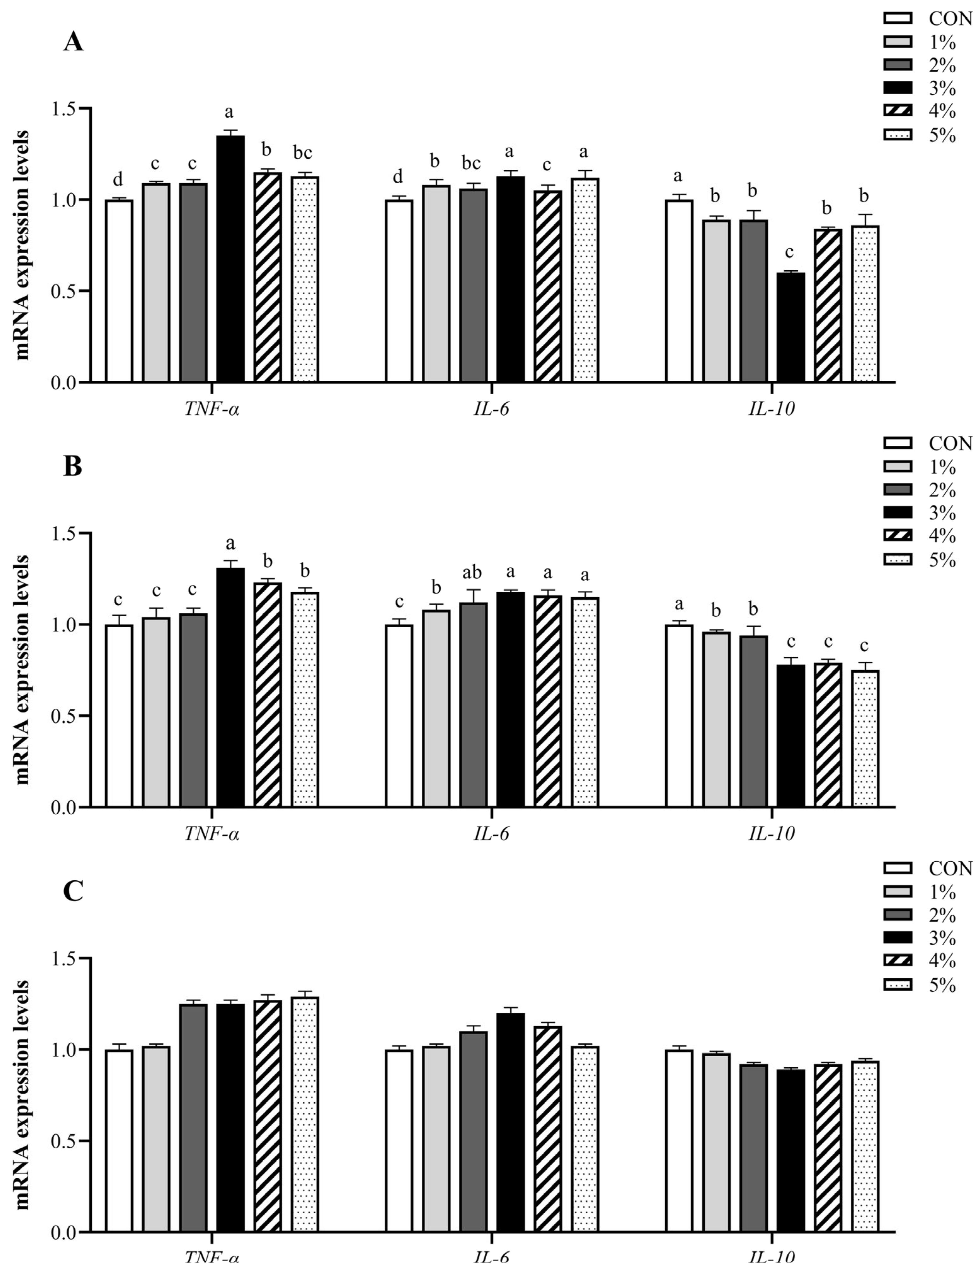
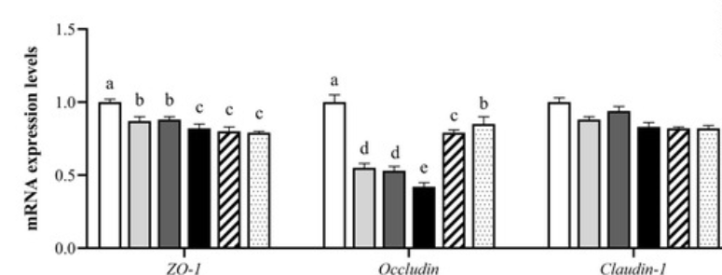
β-CON < 25000 ppm in feed - background
Inflammation biomarkers -Jejunum d21
Control
Gut-integrity biomarkers -Jejunum d21
Chronic inflammation diverts resources from growth and performance and increases the susceptibility to gut-health issues
Du et al., 2023

Slide 13
Low ANF and high digestibility are not enough. The protein for critical periods also needs Fast absorption

Slide 14
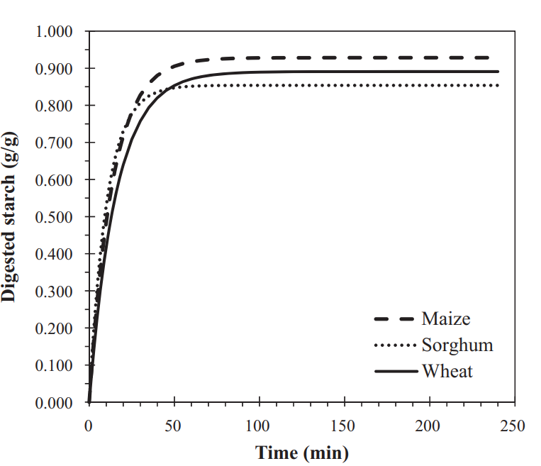
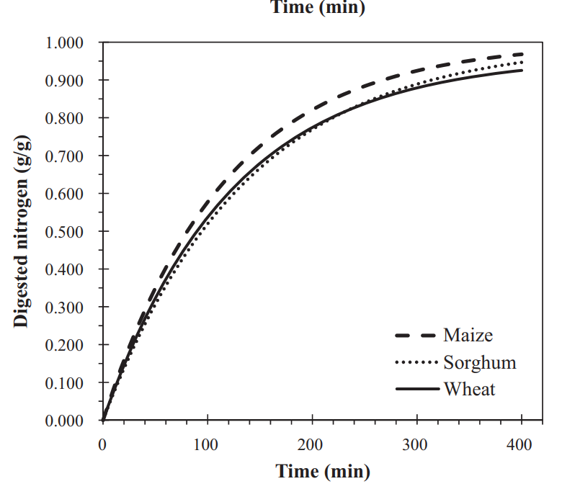
Starch and Nitrogen digestion curves
Complete broiler diets based on maize, sorghum, and wheat + SBM and canola meal
Chrystal, 2020

Slide 15
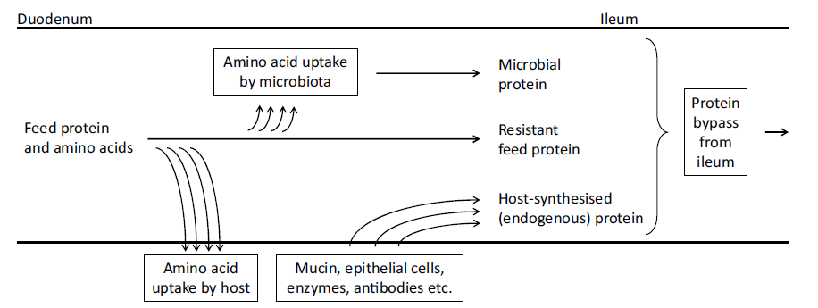
Protein digestion
Adebowale et al., 2019

Slide 16
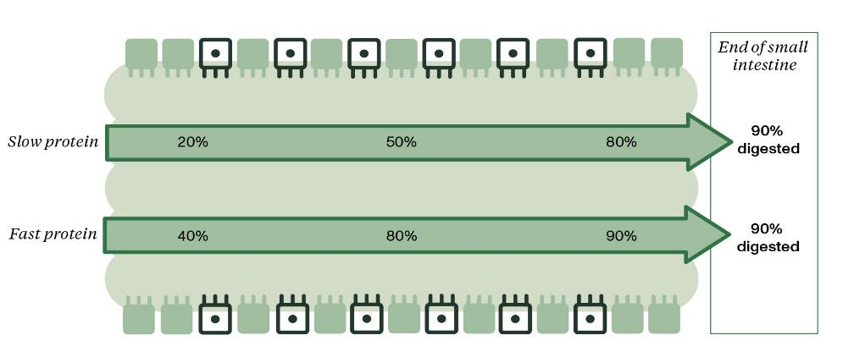
Same digestibility but different absorption speed
In conventional diets, the faster a protein is digested, the more it can be used for growth
Synchronization of energy and protein absorption

Slide 17
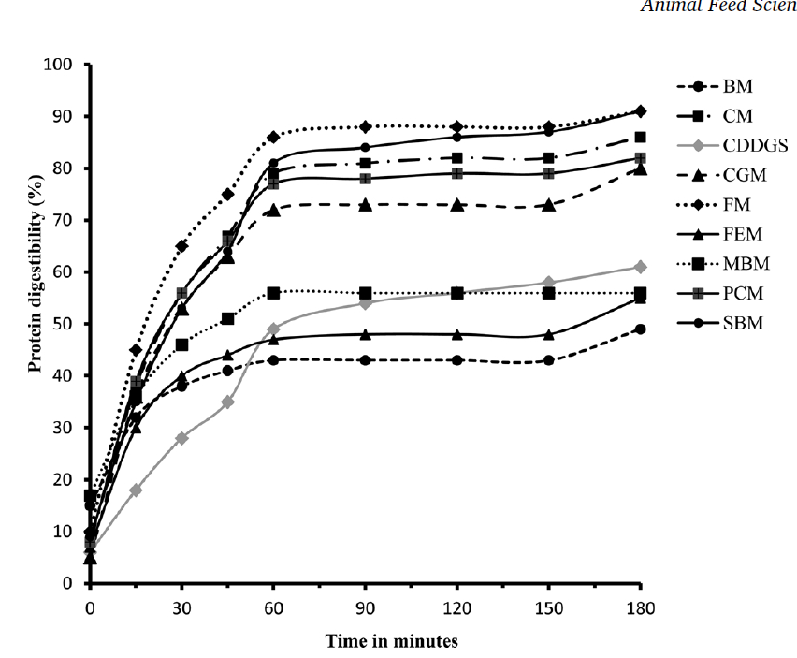
in vitro Protein digestion
Dervan et al., 2019

Slide 18
in vitro Protein digestion
pH-stat method - Hamlet Protein & Aarhus University
100
95
90
85
Fast protein (%)
80
75
70
92
65
83
83
87
84
60
78
79
78
80
79
72
74
55
67
59
63
56
54
63
50
0
18
SBM
HP 300
AviStart
HP 270
AviSure
Extruded soy
Fermented soy
SPC
Fermented corn
Corn gluten meal
Potato protein
Faba protein concentrate
Hydrolyzed wheat gluten
Cotton seed protein concentrate
Whey protein concentrate
Whey protein
Blood plasma
Fish meal
Hydrolisate from porcine
Yeast protein extract

Slide 19
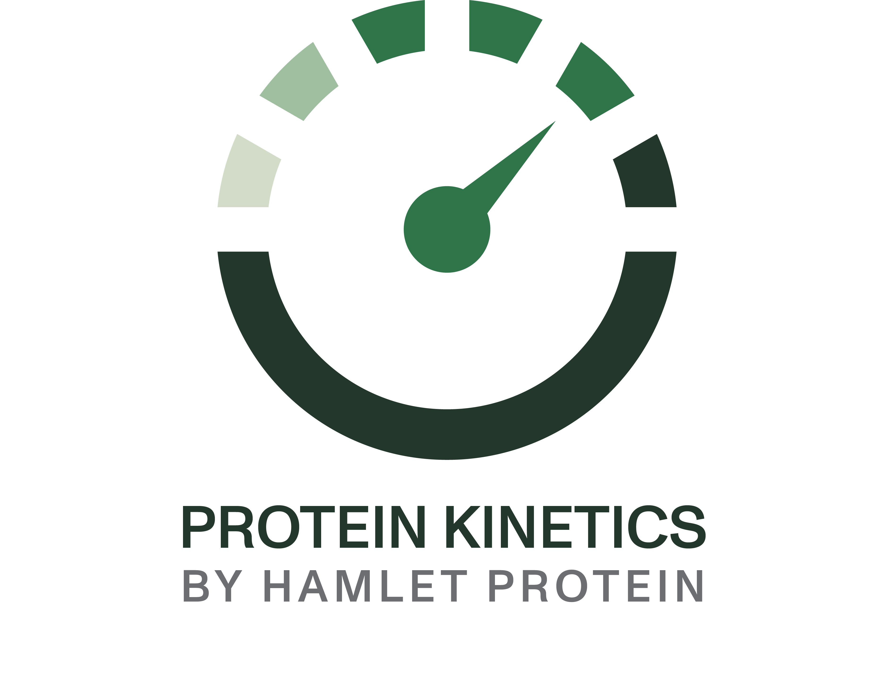
Protein kinetics
Explained in 4 easy steps
1 Faster protein hydrolysis in proximal small intestine
2 Faster absorption of amino acids in blood
3 Increased protein availability for tissues, and organs
4 Increased protein deposition and lower FCR

Slide 20
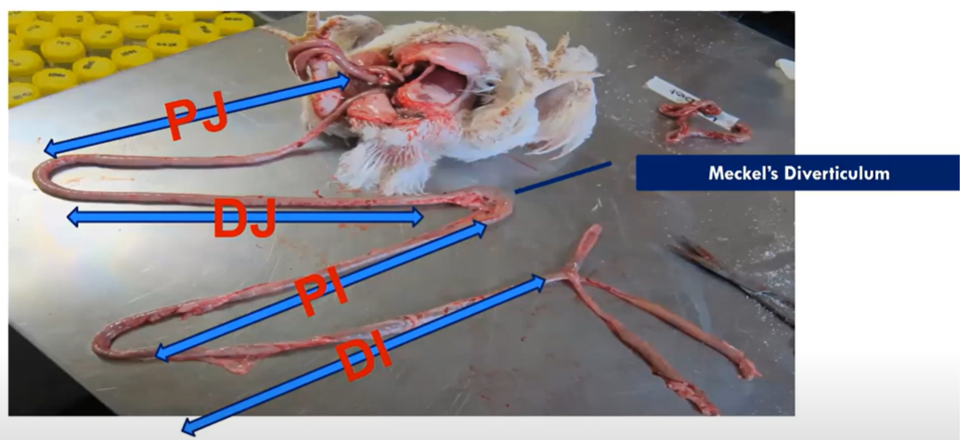

Slide 21
Protein kinetics 1: digestion
Sydney University
Data at day 14 of feeding the experimental diets
Caged broilers Ross 308: 3 groups, 8 reps of 21 birds
Corn-SBM based diets
 | Control | HP Avistart 5.0% | HP Avistart 7.5%
Corn | 61.40% | 61.00% | 60.80%
SBM | 30.60% | 26.20% | 24.00%
HP Avistart | - | 5.00% | 7.50%
Added AA | 1.63% | 1.45% | 1.36%
AME (kcal/kg) | 2980 | 2980 | 2980
Lys | 1.30% | 1.30% | 1.30%
SAA | 0.99% | 0.99% | 0.99%

Slide 22
Protein kinetics 4: performance
BW: ≈95% of genetic potential, 1 to 1.6% of increase at day 14

Slide 23
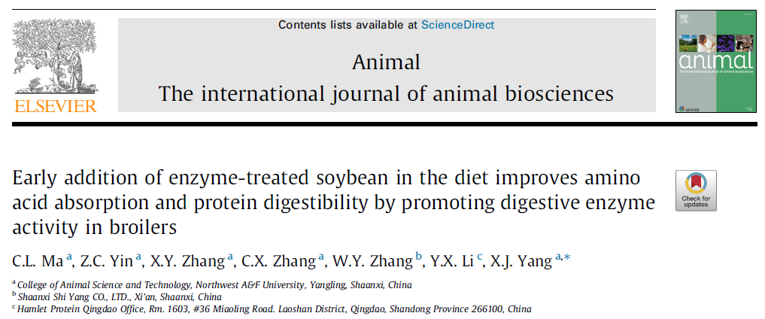
Higher digestibility of dry matter and crude protein
Research at the University of Northwest A&F Yangling, Shaanxi, China
Feeding period: 10 days – 5% ESBM
Duration: 42 days
Broilers in cages: 2 groups, 10 repetitions of 15 AA broilers
 | Control | ESBM 5.0%
Corn | 58.40% | 58.62%
SBM | 22.00% | 14.69%
Cottonseed meal | 11.56% | 11.58%
Added AA | 0.39% | 0.36%
AME (kcal/kg) | 2796 | 2798
Crude protein % | 22.18% | 22.17%
Lysine | 1.39% | 1.38%
Ma et al., 2024

Slide 24
Higher proteolytic enzyme activity in digesta at day 10
Protein Kinetics
1 – Digestion
Control
HP ESBM 0 – 10 days
*Indicate statistically significant differences (P<0.05)
Ma et al., 2024

Slide 25
Higher expression of amino acid transporters at day 10
Protein Kinetics
2 – Absorption
Control
HP ESBM 0 – 10 days
*Indicate statistically significant differences (P<0.05)
Ma et al., 2024

Slide 26
Higher serum amino acids at day 10
Protein Kinetics
3 – Portal circulation of amino aids
Control
HP ESBM 0 – 10 days
*Indicate statistically significant differences (P<0.05)
Ma et al., 2024

Slide 27
Improved performance
Protein Kinetics
4 – Tissue deposition/performance
Control
HP ESBM 0 – 10 days
+130 grams
+15 grams
*Indicate statistically significant differences (P<0.05)
Ma et al., 2024

Slide 28
Improved gut health biomarkers
Protein Kinetics
4 – Tissue deposition/performance
Control
HP ESBM 0 – 10 days
*Indicate statistically significant differences (P<0.05)
Ma et al., 2024

Slide 29

Protein kinetics in vivo – results
Increase in endogenous protease activity:
≈ 2x of the control group in all intestinal segments
Hydrolyzing: proteins to peptides
peptides to amino acids
Protein Kinetics
1 - Digestion
CAT1
PEPT1
CAT1
EAAT3
Protein Kinetics
2 - Absorption
Increase in expression of peptide and amino acid transporters
≈ 2x of the control group for PEPT1, LAT1, CAT1, EAAT3
Compared with SBM:
20% higher protein absorption in the proximal jejunum
LAT1
LAT2
Protein Kinetics
3 - Portal circulation
Increase in blood amino acids:
≈ 1.5x of the control group for total AA
≈ 2x of the control group for lysine and arginine
Ma et al., 2024

Slide 30
What can we bring into practice?

Slide 31
Does fast protein in the starter phase work at different performance levels?
*Starter phase from 0 to 14 days
Data from 2018 to 2024

Slide 32
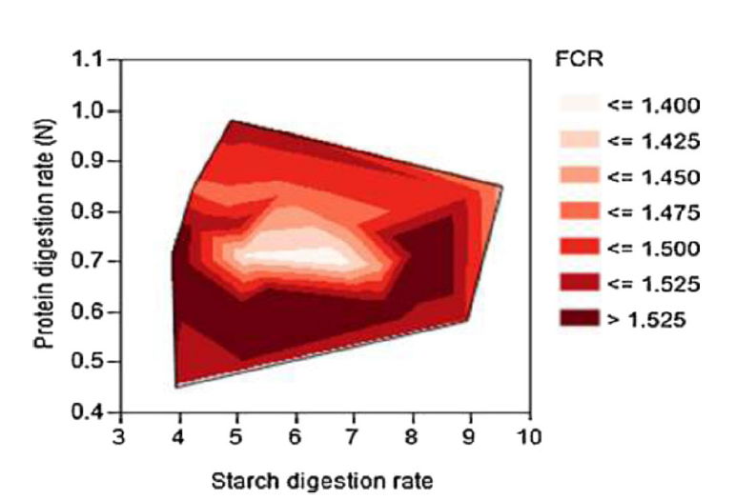
In practice: keep an eye on fast protein sources and quantity
Including more fast protein in poultry starter diets has an economic return: it increases protein deposition and performance at the end of the cycle.
How much fast protein?
The quantity of fast protein to include depends on different conditions…
Monitor fast protein
Increase it in diets for critical periods.
Liu et al., 2014

Slide 33
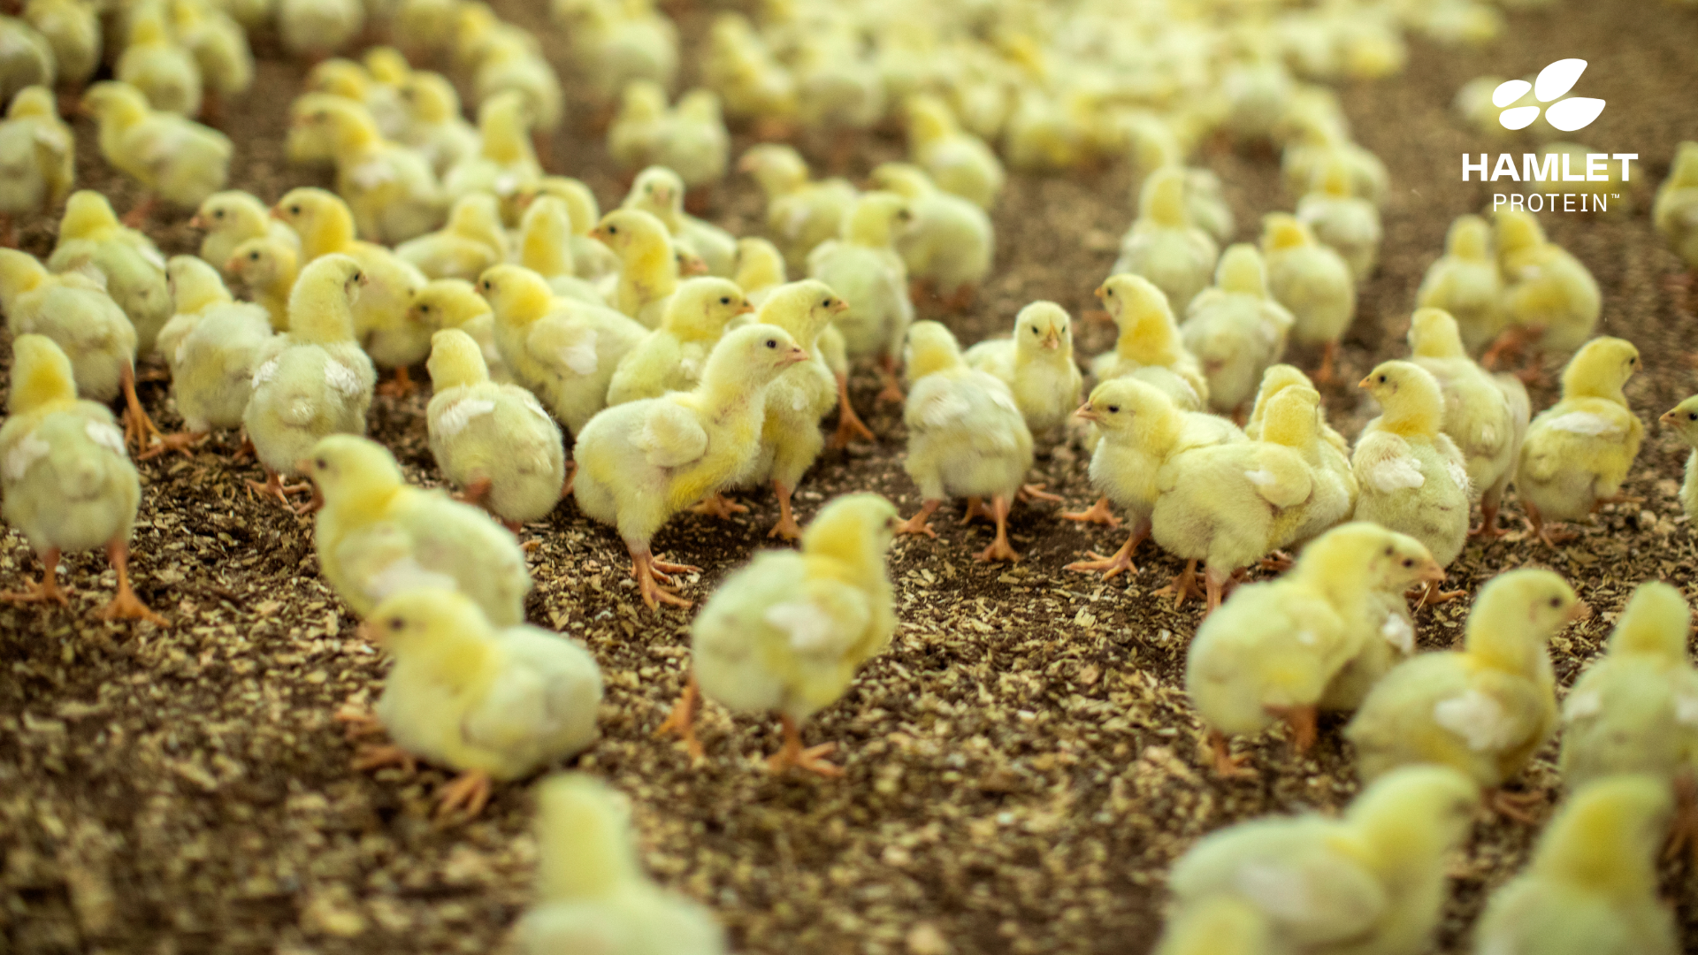
Hamlet Protein Protein for critical periods.

